Slide 1
2023.5.4从芭蕾到拳击

Slide 2
Appreciate the Vedio “ Billy Elliot”(题源？）
The life of 11-year-old Billy Elliot, a coal miner's son in Northern England, is forever changed one day when he stumbles upon a ballet class during his weekly boxing lesson. Before long, he finds himself in dance, demonstrating the kind of raw talent seldom seen by the class' exacting instructor, Mrs. Wilkinson. With a tart tongue and a never-ending stream of cigarettes in her hand, Mrs. Wilkinson's zest for teaching is revived when she sees Billy's potential.

Slide 3
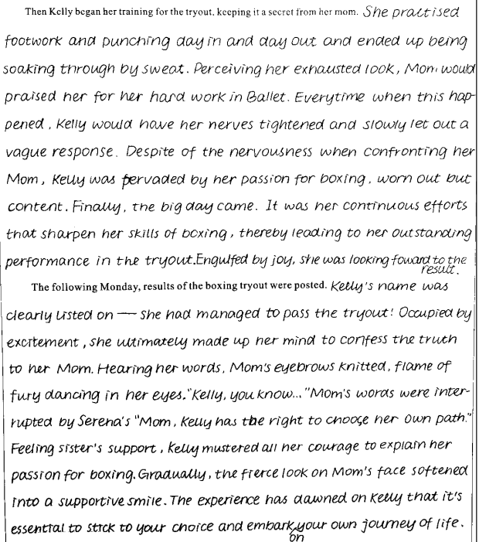
23-24

Slide 4
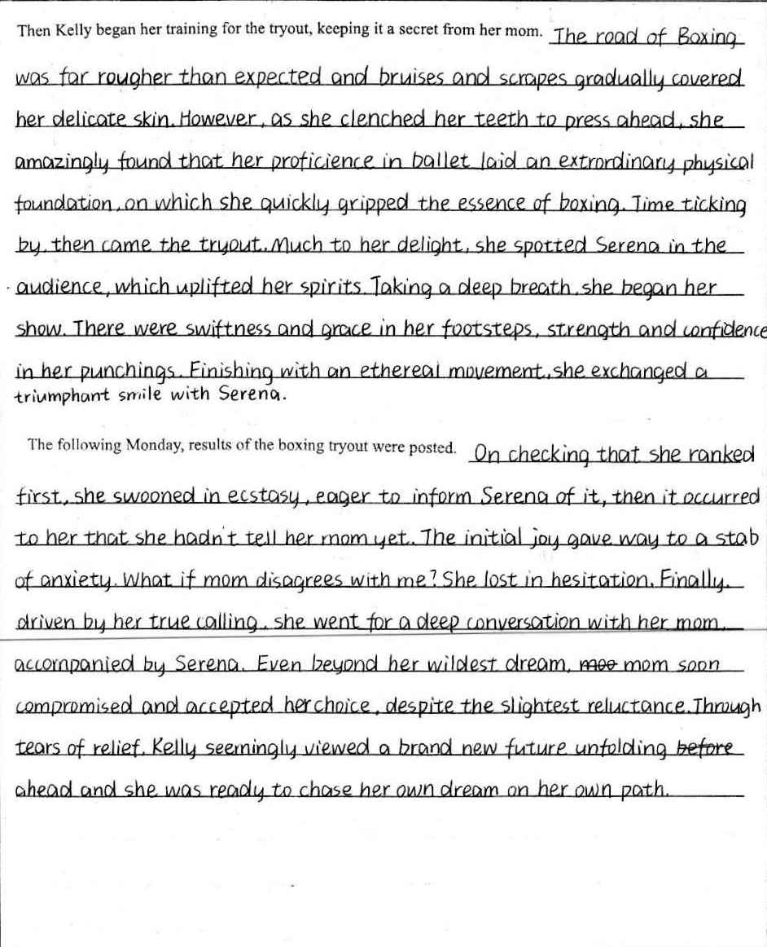

Slide 5
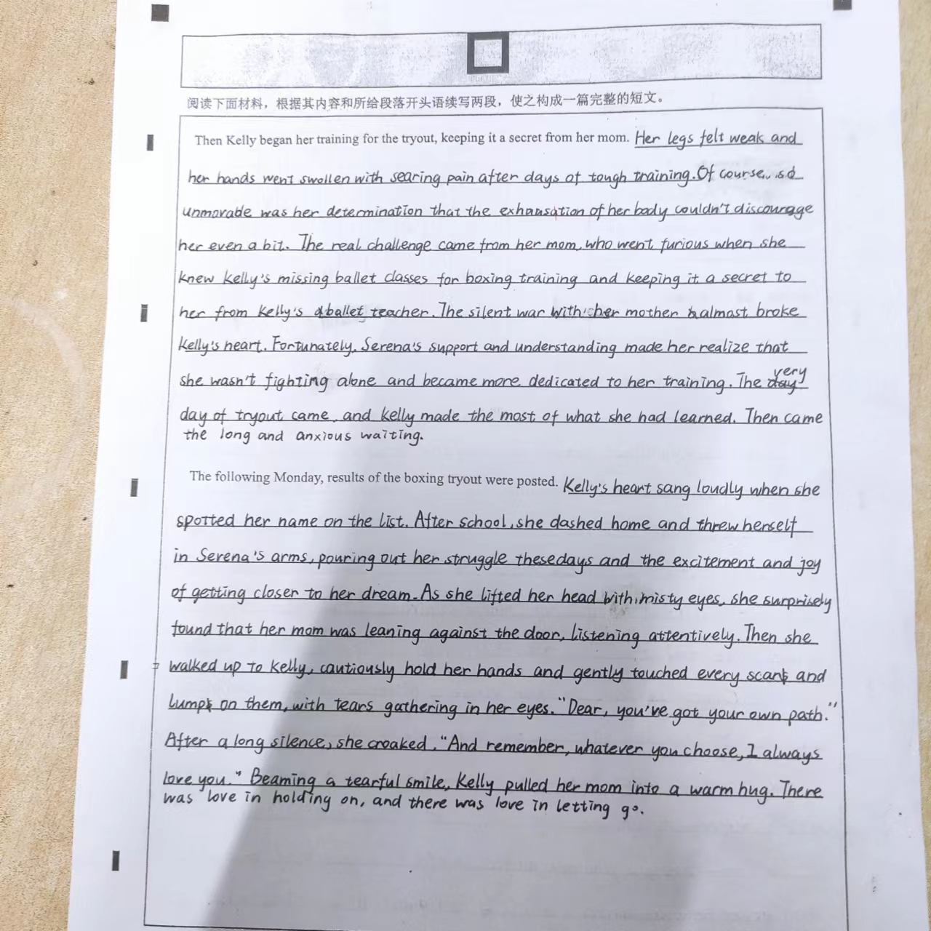
19-20？

Slide 6
Jade’s original version ( Para 1)
Then Kelly began her training for the tryout, keeping it a secret from her mom. Her legs felt weak and her hands went swollen with searing pain after days of tough training. So unmovable was her determination that the exhaustion of her body couldn’t discourage her even a bit. The real challenge came from her mom, who went furious when she knew Kelly’s missing ballet classes for boxing training and keeping it a secret to her from Kelly’s Ballet teacher. The silent war with her mom almost broke Kelly’s heart. Serena’s support and understanding made her realize that she wasn’t fighting alone and became more dedicated to her training. The very day of tryout came and Kelly made the most of what she had learned. Then came the long and anxious waiting.

Slide 7
Jade’s original version (Para 2)
The following Monday, results of the boxing tryout were posted. Kelly’s heart sang loudly when she spotted her name on the list. After school, she dashed home and threw herself into Serena’s arms, pouring out her struggle these days and the excitement and joy of getting closer to her dream. As she lifted her head with misty eyes, she surprisedly found that her mom was leaning against the door, listening attentively. Then she walked up to Kelly, cautiously held her hands and gently touched every scar and lump on them, with tears gathering in her eyes. “Dear, you’ve got your own path.” After a long silence, she croaked, “ And remember, whatever you choose, I always love you.” Beaming a tearful smile, Kelly pulled her arm into a warm hug. There was love in holding on and there was love in letting go.

Slide 8
Jade’s version polished by Kelly & AI (Para 1)
Then Kelly began her training for the tryout, keeping it a secret from her mom. After several days of tough training, her legs felt weak and her hands were swollen with searing pain. However, her unbreakable determination didn't allow the exhaustion of her body to discourage her even a bit. Her biggest challenge came from her mom, who became furious upon discovering that Kelly had been missing ballet classes for boxing training and making excuses before her ballet teacher. The silent war with her mom almost shattered Kelly's heart, but Serena's unwavering support and understanding made her realize that she wasn't alone in this battle, and this dedication pushed her to train even harder.The long-awaited day of the tryout finally arrived, and Kelly gave it her all. Then came the anxious waiting.

Slide 9
Jade’s version polished by Kelly & AI (Para 2)
The following Monday, the results of the boxing tryout were posted. Kelly was over the moon when she saw her name on the list. She dashed home after school and threw herself into Serena's arms, pouring out her struggles and excitement at getting closer to her dream. As she lifted her head with misty eyes, she was surprised to see her mom leaning against the door, attentively listening. Walking up to Kelly, her mother cautiously held her hands and gently touched every scar and lump on them, tears gathering in her eyes. "Dear, you've got your own path," she said after a long silence. "And remember, whatever you choose, I will always love you." Beaming a tearful smile, Kelly pulled her into a warm hug. There was love in holding on and there was love in letting go.

Slide 10
作者：李金秋Michelle 审稿 ：梁向群Kelly （Para 1)
Then Kelly began her training for the tryout, keeping it a secret from her mom. With her sister siding with her and helping make up an excuse for her coming home late, Kelly’s heart was injected with new energy. She went to the gym every day, observing carefully and training hard with other candidates, which proved that this was not just her whim. Besides, the determined girl surfed the Internet, diving into the study of up-to-date contests as well as training strategies. The big day Kelly had been longing for arrived. Sparing no effort to move fast and hit hard under the spotlight, she found her best self in the boxing ring, not on the ballet stage.

Slide 11
作者：李金秋Michelle 审稿 ：梁向群Kelly （Para 2)
The following Monday, results of the boxing tryout were posted. Nervousness seized Kelly when she stood in front of the poster. Wild with joy, she spotted her name and then literally flew back to the dancing club, telling Serena the good news. But what about mom? Her heart sank. With Serena’s encouragement, she poured out the whole story to mom. After hearing everything, mom’s knitted eyebrows gradually smoothed. “You are right, my girl. This is your own life, not mine.” Definitely, it was boxing chosen by Kelly that reshaped her new strength and carved her own path, which reminded both of them that famous poem, “I am the master of my fate. I am the captain of my soul.”

